Slide 1

ITEC 493: IT Security for Managers
Advanced cryptography
Ali Mazloum
Integrated Information Technology Department
College of Engineering and Computing
University of South Carolina
Fall 2025

Slide 2
Objectives
Public key infrastructure (PKI)
Digital Certificates
Certificate Authorities

Slide 3
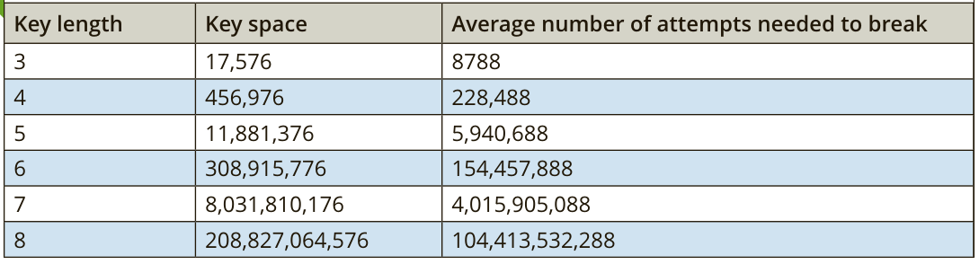
Key Strength
There are three primary characteristics that determine the resiliency of the key to attacks:
Randomness
Length of the key. Shorter keys can be more easily broken than longer keys
Cryptoperiod: the length of time for which a key is authorized for use

Slide 4
Why is randomness important?

Slide 5
Algorithm Input Values
Some cryptographic algorithms require that in addition to a key another value can or must be input
It is generally assumed that these values are visible to attackers
The strength of the cryptographic algorithms should not depend on the secrecy of these values
What would be an example of one mechanism that uses another value than the key?

Slide 6
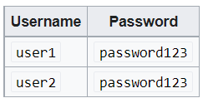
Salt
A salt is a value that can be used to ensure that plaintext, when hashed, will not consistently result in the same digest
Often used in password-based systems
Prevents attackers from generating digests of commonly used passwords or dictionary words that can be compared to the digest of a stolen password

Slide 7
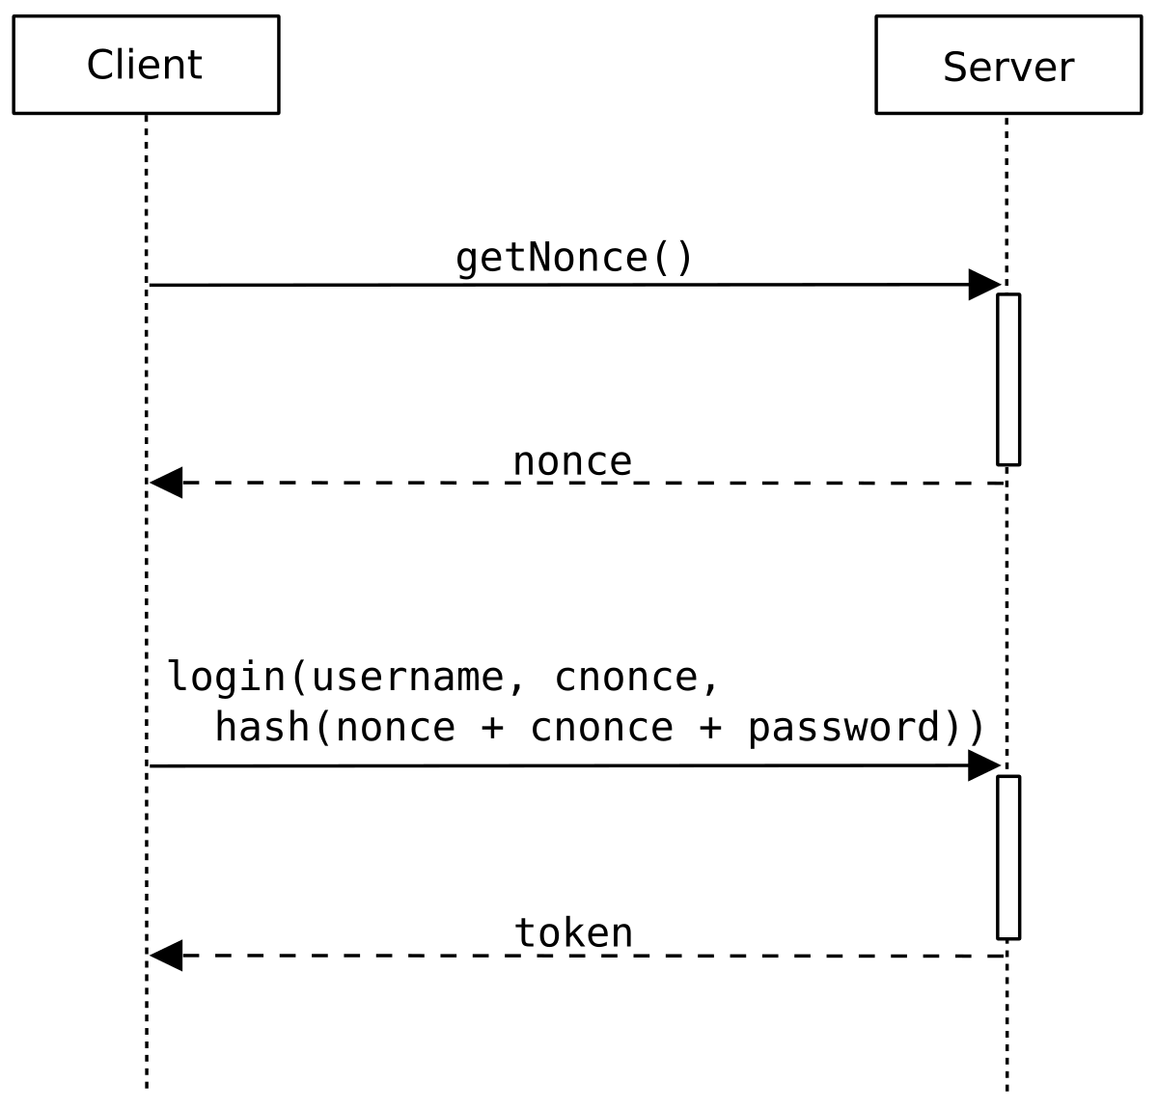
Nonce
(number used once), must be unique
An initialization vector (IV) is the most widely used algorithm input
Often a random number is issued in an authentication protocol to ensure that old communications cannot be reused in replay attacks

Slide 8
Why do we use nonce and cnonce?

Slide 9
Crypto Service Providers
A crypto service provider allows an application to implement an encryption algorithm for execution
Crypto service providers implement cryptographic algorithms, generate keys, provide key storage, and authenticate users
Crypto service providers can be implemented in software, hardware, or both

Slide 10
Digital Certificates
Proof can be provided with asymmetric cryptography by creating a digital signature
However, there is a weakness with digital signatures:
They do not confirm the true identity of the sender
Digital signatures only show that the private key of the sender was used to encrypt the digital signature
But they do not definitively prove who the sender was

Slide 11
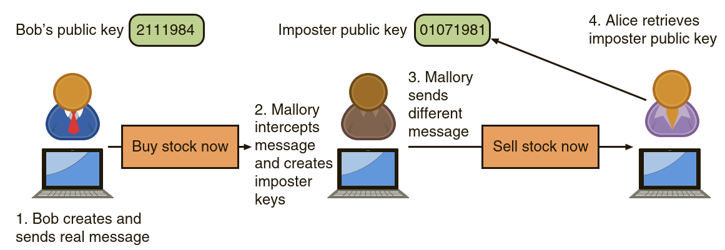
Digital Certificates

Slide 12
Digital Certificates
A digital certificate is a technology used to associate a user’s identity to a public key and that has been digitally signed by a trusted third party
This third party verifies the owner and that the public key belongs to that owner

Slide 13
Digital Certificates
When Bob sends a message to Alice, he does not ask her to retrieve his public key from a central site
Instead, Bob attaches the digital certificate to the message
When Alice receives the message with the digital certificate, she can check the signature of the trusted third party on the certificate

Slide 14
Digital Certificate Elements
If a user wants a digital certificate she must, after generating the public and private keys to be used, complete a Certificate Signing Request (CSR)
The user electronically signs the CSR by attaching her public key and then sending it to an intermediate Certificate Authority (CA)
The intermediate CA, of which there are many, processes the CSR and verifies the authenticity of the user
The intermediate CAs perform functions on behalf of a certificate authority (CA) that is responsible for digital certificates

Slide 15
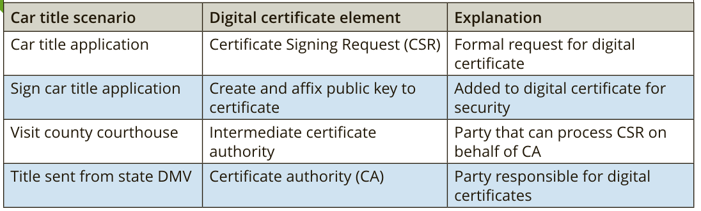
Digital Certificate Car Analogy

Slide 16
CSR Authentication
The person requesting a digital certificate can be authenticated by:
Email
Documents: birth certificate or a copy of an employee badge that contains a photograph
In person. In some instances, the intermediate CA might require the applicant to apply in person to prove his existence and identity by providing a government-issued passport or driver’s license.
A compromised root CA would taint all its intermediate CAs along with all the digital certificates that they issued

Slide 17





Authentication
How can users truly know with whom they are communicating?
Browser
Browser
Website
public
private
Vetting
Certificate Authority
is indeed BoA
Certificate
The owner of
Certificate

Slide 18
Authentication
How can users truly know with whom they are communicating?
Browser
Website
public
Certificate
private
Certificate Authority

Slide 19
Authentication
How can users truly know with whom they are communicating?
✓
Browser
Website
public
Certificate
Certificate
private
Certificate Authority

Slide 20
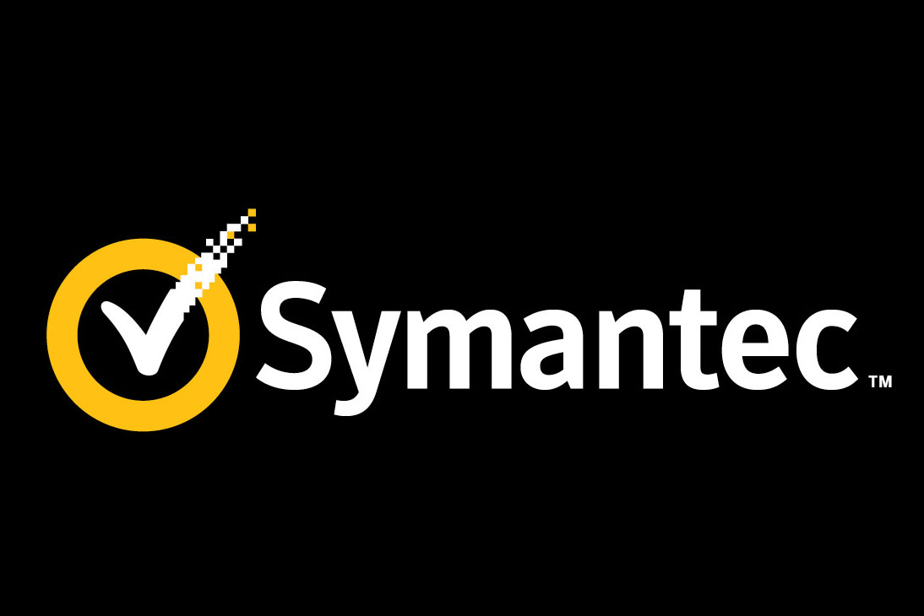
Verifying Certificates
✓
Certificate
“I’m
because I say so!”
✓
Certificate
“I’m
because
says so”
Browser
✓
Certificate
“I’m
because
says so”

Slide 21
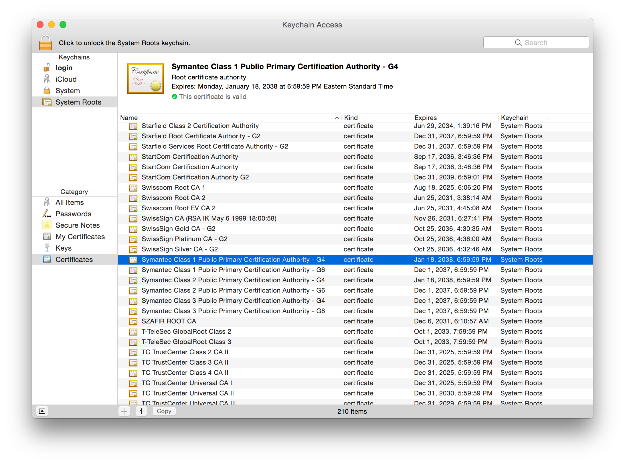
Verifying certificates
✓
Certificate
“I’m
because I say so!”
Root key store
✓
Every device has one Must not contain malicious certificates
Certificate
“I’m
because
says so”
Browser
✓
Certificate
“I’m
because
says so”

Slide 22
Trusted Root Certificates Store
Root key store
Every device has one Must not contain malicious certificates

Slide 23
Certificate Revocation
Digital certificates normally have an expiration date, such as one year from the date they were issued
Certificate can be revoked before it expires
Someone were to steal a user’s private key
The status of a certificate can be checked
Certificate Revocation List (CRL): online or local list of certificate serial numbers that have been revoked
Online Certificate Status Protocol (OCSP): performs a real-time lookup of a certificate’s status

Slide 24
Certificate Revocation
Download CRL
CRL
User
CA
Directory
CRL
Certificate IDs
to be checked
Download
CRL
User
OCSP
Server
CRL
CA
Answer about
Certificate States
Directory
OCSP

Slide 25
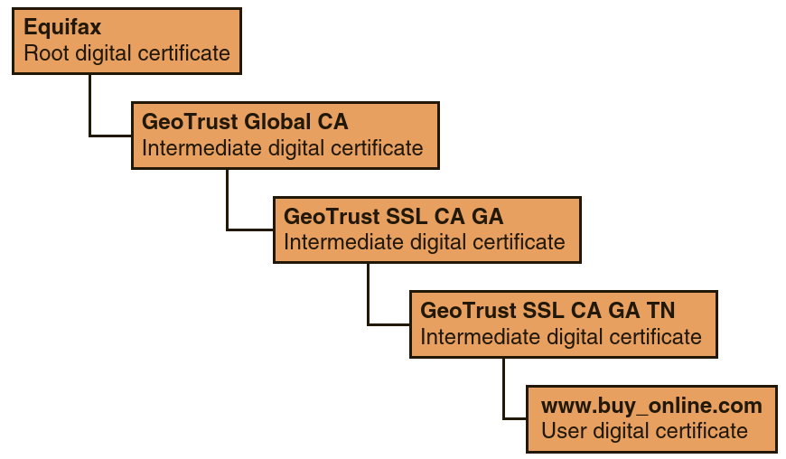
Types of Digital Certificates
The process of verifying that a digital certificate is genuine depends upon certificate chaining
Root digital certificates are self-signed

Slide 26
Certificate Chaining
Why not issue all certificates off the root digital certificate and eliminate the need for certificate chaining?
This would require an online CA that could compromise its security.

Slide 27
Types of Digital Certificates
Root digital certificates and intermediate certificates are packaged as part of modern operating systems

Slide 28
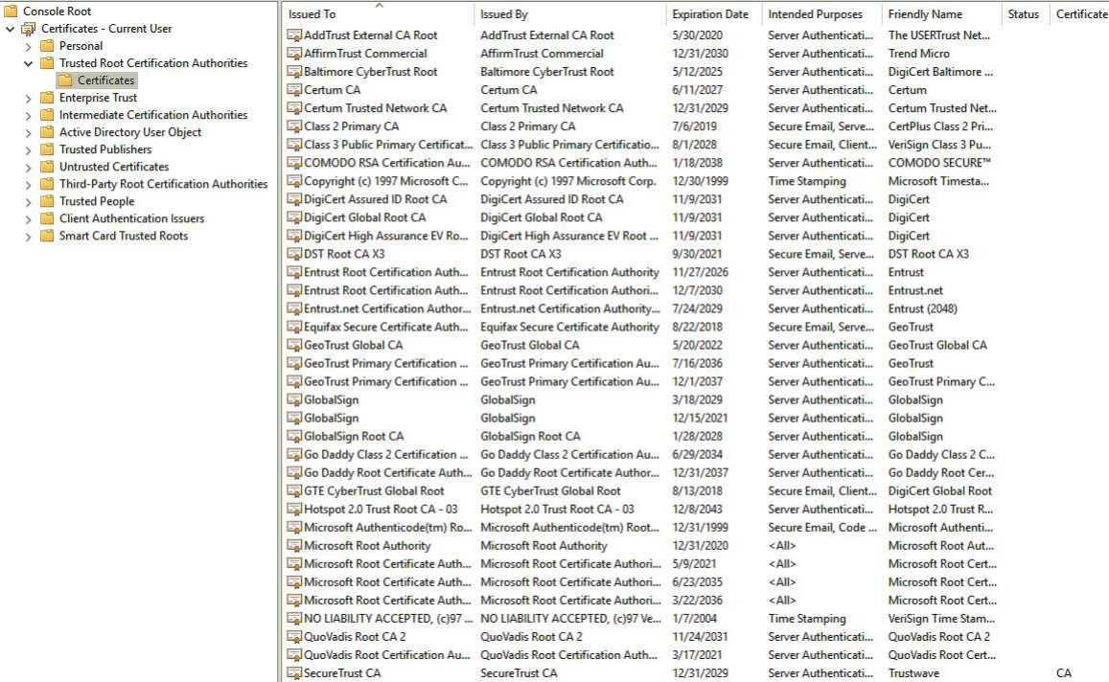
Types of Digital Certificates

Slide 29
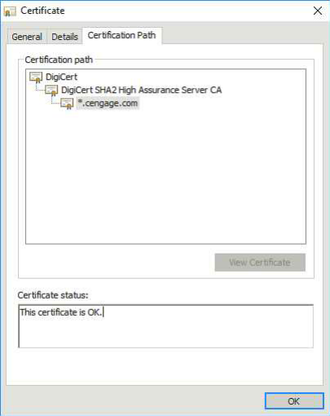
Types of Digital Certificates
Certificate chaining and root digital certificates can be seen by using a web browser to access the Cengage website
The root digital certificate (DigiCert) verifies the intermediate certificate (DigiCert SHA2 High Assurance Server CA)
Intermediate certificate authenticates the digital certificate for the Cengage site (*.cengage.com)

Slide 30
Domain Digital Certificates
Most digital certificates are web server digital certificates that are issued from a web server to a client
They ensure the authenticity of the web server to the client
Web servers can set up secure cryptographic connections so that all transmitted data is encrypted by providing the server’s public key with a digital certificate to the client (key exchange)

Slide 31
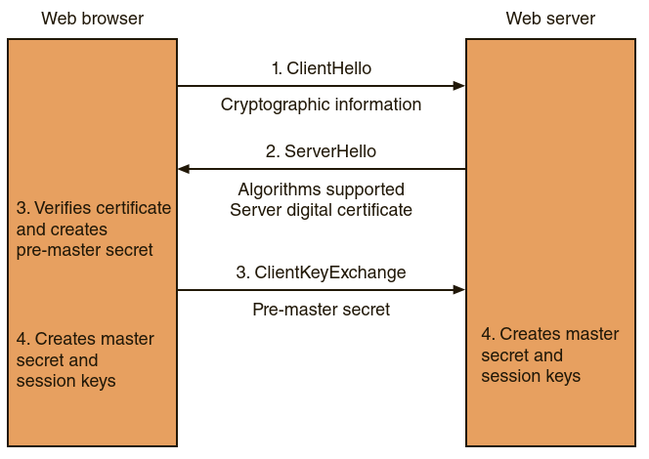
Key Exchange
Notes:
The web browser sends a message (“ClientHello”) to the server that contains information including the list of cryptographic algorithms that the client supports
The web server responds (“ServerHello”) by indicating which cryptographic algorithm will be used. It then sends the server digital certificate to the browser
The web browser verifies the server certificate (such as making sure it has not expired) and extracts the server’s public key. The browser generates a random value (called the pre-master secret), encrypts it with the server’s public key, and sends it back to the server (“ClientKeyExchange”).
The server decrypts the message and obtains the browser’s pre-master secret. Because both the browser and server now have the same pre-master secret, they can each create the same master secret. The master secret is used to create session keys, which are symmetric keys to encrypt and decrypt information exchanged during the session and to verify its integrity.

Slide 32


Domain Digital Certificates
Domain Validation
Verifies the identity of the entity that has control over the domain name
Can be automated
Extended Validation (EV)
Requires more extensive verification of the legitimacy of the business
Wildcard digital certificate
Validate a main domain along with all subdomains

Slide 33
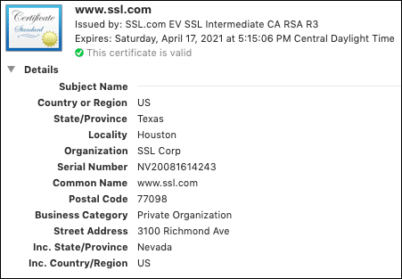
Digital Certificate Formats
The most widely accepted digital certificates are defined by a division of the International Telecommunication Union (ITU)
Known as the Telecommunication Standardization Sector (ITU-T)
These digital certificates adhere to the X.509 standard

Slide 34
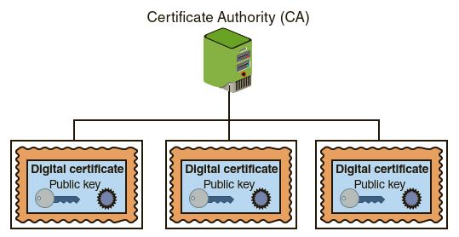
Hierarchical Trust Model
The hierarchical trust model assigns a single hierarchy with one master CA called the root.
This root signs all digital certificate authorities with a single key
A hierarchical trust model can be used in an organization where one CA is responsible for only the digital certificates for that organization
If the CA’s single private key were to be compromised, then all digital certificates would be worthless

Slide 35
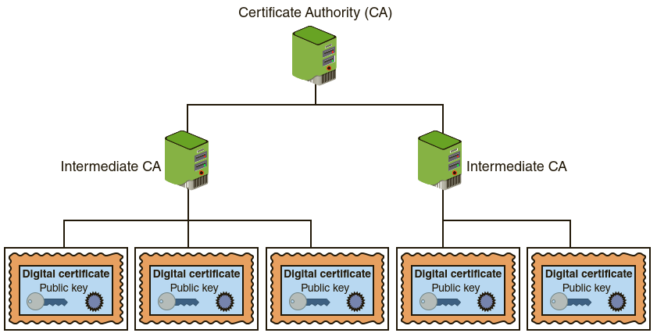
Distributed Trust Model
Distributed trust model has multiple CAs that sign digital certificates
The loss of a CA’s private key would compromise only those digital certificates for which it had signed
The workload of verifying and signing digital certificates can be distributed
CAs can delegate authority to other intermediate CAs to sign digital certificates

Slide 36
Certificate Life Cycle
Digital certificates should not last forever
Creation. At this stage the certificate is created and issued to the user
Suspension. This stage could occur once or multiple times throughout the life of a digital certificate if the certificate’s validity must be temporarily suspended (e.g., employee on a leave)
Revocation. At this stage the certificate is no longer valid (e.g., private key compromised)
Expiration. At the expiration stage the certificate can no longer be used (i.e., expiration date passed)

Slide 37
Cryptographic Transport Protocols
Secure Sockets Layer (SSL)
Transport Layer Security (TLS)
SSL and TLS are often used interchangeably or even in conjunction with each other (TLS/SSL)
Cipher suites typically use descriptive names to indicate their components.
For example, CipherSuite SSL_RSA_WITH_RC4_128_MD5 specifies that
RSA will be used for key exchange and authentication algorithm,
RC4 encryption algorithm using a 128–bit key will be used
and MD5 will be the MAC algorithm.

Slide 38
Secure Applications / Protocols
Secure Shell (SSH)
Used to access remote computers
Both the client and server ends of the connection are authenticated using a digital certificate, and passwords are protected by being encrypted.
SSH can even be used as a tool for secure network backups
Hypertext Transport Protocol Secure (HTTPS)
Secure Hypertext Transport Protocol (HTTP) communications between a browser and a web server
HTTPS uses port 443 instead of HTTP’s port 80

Slide 39
Secure Applications / Protocols
Secure/Multipurpose Internet Mail Extensions (S/MIME)
Protocol for securing email messages.
It allows users to send encrypted messages that are also digitally signed
Secure Real-time Transport Protocol (SRTP)
SRTP is a secure extension protecting transmissions using the Real-Time Transport Protocol (RTP)
Protection for Voice over IP (VoIP) communications

